Slide 1

KNOWLEDGE INSTITUTE OF TECHNOLOGY, SALEM – 637504
(Autonomous Institution)
Machine Vision Based Bolt and Nut Inspection System for Defect Detection
Batch No.: 04
Club Name: SMART AUTOMATION CLUB
Team Members: Logeshwaran B, Bhuvanan M, Karthikeyan V, Veera karthikeyan R, Jayasubramani S
Full Affiliation: III Year MECH, Knowledge Institute of Technology. Salem.
Name of the Mentor: Prof P. Karthikeyan
Presentation Date: 25.03.2026

Slide 2
Solutions Generated (Customer/Industry Defined Problem)
• Manual inspection of bolts and nuts results in low accuracy and human error.
• Missing or loose bolts may cause machine damage and safety issues in industries.
• Continuous monitoring in production line is difficult using manual method.
• Small defects like missing bolt, loose nut, wrong position, and improper tightening are hard to detect.
• Existing inspection systems are slow and require more manpower.
• Industry needs an automatic, fast, and reliable inspection system.
• Proposed Solution:
Machine Vision Based Bolt and Nut Inspection System using Camera and Image Processing for Defect Detection.

Slide 3
Final Solution with Key Assumptions
• Camera-based machine vision system is used to capture bolt and nut images.
• Image processing / AI model detects missing, loose, and misaligned bolts.
• Proper lighting and fixed camera position are assumed for accurate detection.
• System is designed for industrial production line inspection.
• Output displays OK / NOT OK result automatically for defect detection.

Slide 4
Brainstroming
No | Idea Generated | Description
1 | Manual visual inspection method | Checking bolts and nuts manually by operator
2 | Sensor based bolt detection system | Using proximity sensor to detect bolt presence
3 | Camera based inspection system | Using camera to capture bolt and nut images
4 | Image processing defect detection | Detect missing / loose bolt using OpenCV
5 | AI / Machine vision inspection system | Automatic defect detection using trained model

Slide 5
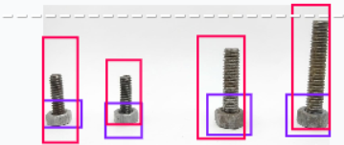
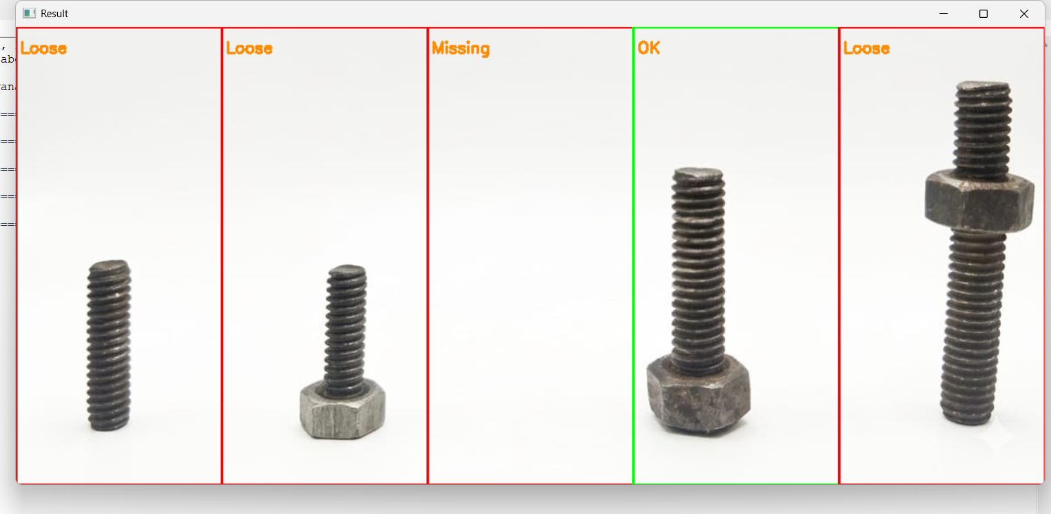
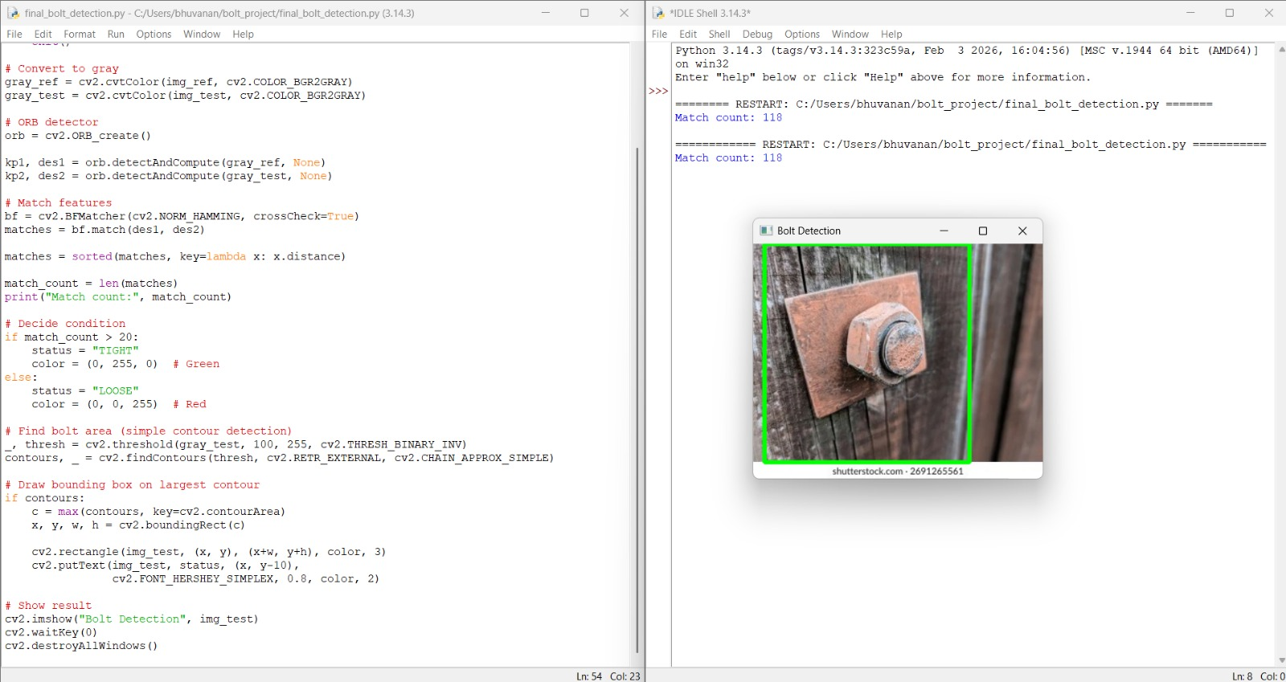
Concept Development – MVP
Developed prototype using camera, computer, and machine vision system.
• Used YOLO model and image processing algorithms for bolt and nut detection.
• Model detects bolts and shows bounding box for correct and wrong parts.
• System displays OK / NOT OK result to the user automatically.
• MVP proves the feasibility of AI based automatic bolt and nut defect inspection system.

Slide 6
Iteration & Solution–Market Fit:
• Initial concept reviewed and improved based on guide and review feedback.
• Different detection methods tested and YOLO model selected for best performance.
• System tested with various bolt and nut conditions for reliability checking.
• Detection speed and accuracy improved for real-time industrial use.
• Final system is suitable for automatic inspection in manufacturing industries.

Slide 7
Comparison:
Parameter | Manual Inspection | OpenCV Method | YOLO / AI Model | Selected
Working principle | Human visual check | Image processing rules | Deep learning detection | YOLO
Speed | Slow | Medium | Fast | YOLO
Accuracy | Low | Medium | High | YOLO
Detect missing bolt | Difficult | Possible | Easy | YOLO
Detect loose / wrong position | Difficult | Limited | Accurate | YOLO
Real-time inspection | Not possible | Limited | Possible | YOLO
Reliability | Medium | Medium | High | YOLO
Cost | Low | Medium | Medium | YOLO
Suitable for industry | Not suitable | Limited | Very good | YOLO
Suitable for automation | No | Partial | Yes | YOLO

Slide 8
Further Plan to Execute
• Collect more bolt and nut images to improve YOLO model accuracy.
• Train the model with different defect conditions like missing, loose, and misaligned bolts.
• Develop complete system for real-time camera-based inspection.
• Integrate software with display to show OK / NOT OK result with bounding box.
• Prepare final prototype and test for industrial application demonstration.

Slide 9
References
• Redmon, J. et al., YOLO: Real-Time Object Detection, IEEE Conference
• OpenCV Official Documentation – https://opencv.org
• Python Software Foundation – https://www.python.org
• Roboflow Object Detection Platform – https://roboflow.com
• Research papers on Automated Visual Inspection in Industry

